Slide 1
Simple Perceptron

Slide 2
Brief History
The idea was first presented by McCulloch and Pitt in 1943
It was also called linear threshold gate
Was capable of producing binary output
Weights and thresholds were fixed
Rosenblatt in 1950 produced perceptron which could modify the weights through iterative algorithm

Slide 3
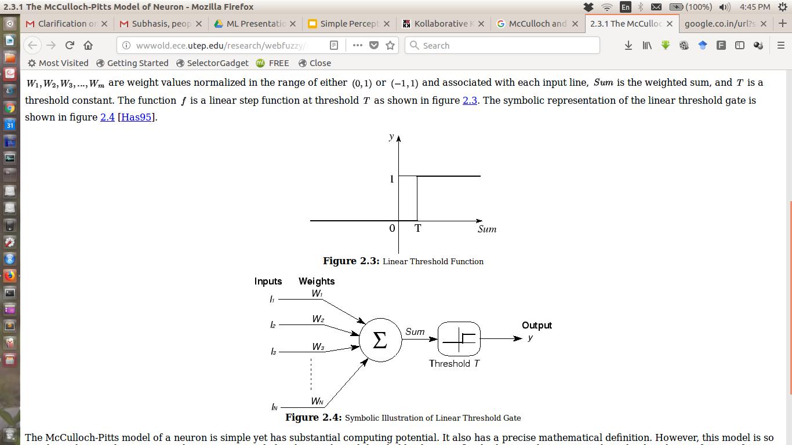
Simple structure (McCulloch and Pitt)
The weights are not updated in their perceptron

Slide 4
Limitations of McCulloch and Pitts model
When compared with human neurons, McCulloch and Pitts model suffers from quite a few limitations such as
Only binary output
Biological neurons send sequence of pulses encoding information whereas McCulloch and Pitts model quite primitive in this respect
Excitatory or Inhibitory neurons are still there in our biological system whose weights do not change sign but this constraint is not there in McCulloch and Pitts model

Slide 5
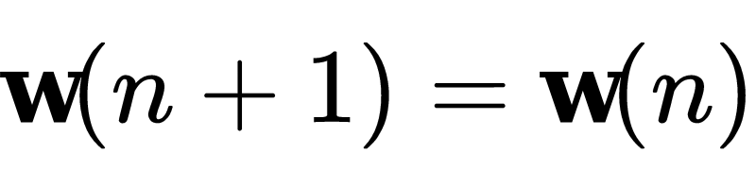
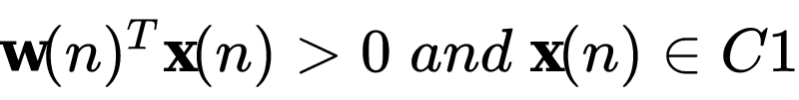
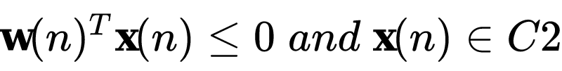
Perceptron update
Separating plane
If a perceptron classifies instances correctly after n iterations, following conditions related to weights will apply
C1
C2
Otherwise

Slide 6
Perceptron convergence theorem
If the classes are linearly separable, then irrespective of initialization, the model will find the optimal separating plane within a finite number of iterations

Slide 7
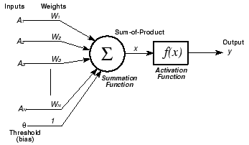
Simple structure (Rosenblatt)
An extra bias term was added
The weights are updated in each iteration based on the following equation
Learning Rate
Input
Actual Output
Desired Output

Slide 8
Simple structure (Rosenblatt)
Rosenblatt built the perceptron by merging two concepts:
McCulloch and Pitts linear threshold gate
Hebbian learning of weight adjustment
Similar to our nerve cell, the neuron should fire (or send a signal) if the output of activation function is above the threshold value
Rosenblatt’s perceptron was very much appreciated and it opened up new area of active research

Slide 9
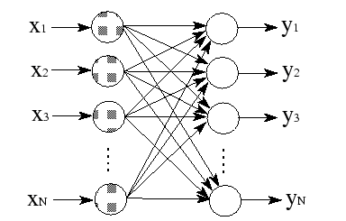
Doing classification with simple Perceptron
A simple perceptron can do classification in two ways as shown below
By using some threshold value(s)
By using softmax algorithm for a fully connected network

Slide 10
Why bias Node in Perceptron?
To deal with cases where all the inputs are zero
Bias Node
0
0
0
0
Output is 0
Output is nonzero
0
Output is 0
0
Output is nonzero
0
0
0
0
Forcefully sending the line through origin
Flexible to adjust the line

Slide 11
Major problem with simple perceptron
Simple perceptron fails to classify classes which are NOT linearly separable
It fails for a dataset as simple as XOR gate
IP1​ | IP2​ | OP​
0​ | 0​ | 0​
0​ | 1​ | 1​
1​ | 0​ | 1​
1​ | 1​ | 0​
No LINEAR plane can effectively separate the two classes and hence even after infinite run, simple perceptron will fail to classify the two classes accurately

